Slide 1
FINANCIAL ANALYSIS
Team Name: Team Blue
Team Members: Kamutam Sainandu
Chinthapula Sharath Kumar
Kotha Vishwak
Neharsha Vishnu Kanneganti
Kamparaju Siddharth
Nithin Teja Janjanam
Name of the mentor: Pravindra Kumar Gole
<Date of presentation>

Slide 2
The problem statement
The organizations are facing challenges in its financial decision-making processes due to the lack of insights into its financial metrics, specifically profit, loss, expenditure, and revenue, on a departmental level. While financial data is available, it is not effectively utilized for strategic planning or performance evaluation. This gap in data utilization hinders the ability to make informed decisions and drives inefficiencies in resource allocation.
The absence of a comprehensive and visually intuitive representation of financial data prevents management from quickly identifying critical trends, anomalies, and areas requiring attention. This limitation impacts the organizations capacity to respond correspondingly to the financial issues, optimize budget allocations, and enhance overall financial health.
To address these challenges, there is a need to develop a robust financial analysis platform. This platform should graphically represent financial data in a manner that is easily understandable. By doing so, it will empower management with the tool necessary to make data-driven decisions, ensure financial transparency, and improve corrections across departments.
About the project
Notes:
Notes:
In this session we look back at MPI Modules 4-6 and explore the concepts in more detail through the lens of some of the readings
Let’s get started

Slide 3
Objectives of the project
OBJECTIVES :
Data Aggregation: Efficiently collecting and consolidate financial data related to expenditure and revenue i.e. transactional data for each department
Data Visualization: Developing intuitive and interactive visualizations using advanced technologies like React, Python ,Flask and My Sql.
Performance Analysis: Conducting in-depth analyses to identify key drivers of financial performance within each department
SUSTAINABLE BENEFITS :
Enhanced Decision-Making: By providing a clear and comprehensive view of financial data, the platform will enable management to make more informed and timely decisions
Resource Optimization: Improved insights into departmental financial performance will help optimize budget allocations and resource utilization, leading to more efficient operations
Market Competitiveness: By leveraging data-driven insights, the organization can remain competitive in the market, adapting quickly to financial challenges and opportunities
Objectives

Slide 4
Graphical representations of financial metrics such as charts, graphs, and tables.
Deliverables
A dynamic dashboard that provides a clear graphical representation of department-wise financial metrics
Graphical representation of financial data in the form of charts, graphs and tables
Transaction history section containing all relevant financial data, organized between selectable dates
A system for generating regular financial reports ( monthly, quarterly, annual) that summarize loss and profit
Capability of understanding for management to identify and act upon financial trends and anomalies
Improved financial management and resource allocation throughout the organization
Data-driven insights that lead to more efficient budget allocations and better financial planning.
Deliverables

Slide 5
Background (past work)
In the past, many organizations have relied on traditional methods of financial analysis, such as manual spreadsheet calculations and static reports. While these methods provide some insights, they are often non visualistic , difficult to understand, lack of interactivity and time consuming
ERP systems like SAP, Oracle, and Microsoft Dynamics offer integrated financial analysis modules. These systems are comprehensive but can be expensive and complex to implement
Comparison with the work available in market:
ERP Systems provide end-to-end financial management but are complex and often include more features than necessary for smaller organizations whereas our project only needs an excel sheet from the organization side
Business Intelligence Tools offer powerful visualization and analysis capabilities but may lack the specific focus on departmental financial metrics without significant customization whereas our project focuses specifically on departmental financial metrics, ensuring relevance and ease of use for the organization.
Designed with user-friendliness in mind, ensuring that stakeholders can easily interpret and act on the data
Background
Notes:
Notes:
In this tutorial we will work through each of the three resources allocated as 30min exercises.
Working in groups with the provided guiding questions you will collate your thoughts and reflections from reading the paper and organize these thoughts in the light of the module’s perspective.
So, for the first module you will take the orientation that the module discusses and contemplate the learnings and meanings identified within the reading from this orientation
Once every group has had a chance to discuss and capture their thoughts, we will share these in short presentations to examine the depth and diversity of views from within the group.

Slide 6
Stakeholders:
Senior Management
Investors and Shareholders
Finance Department
Department Heads
Data Analysts
Project Managers
Data Acquisition:
The transaction data is collected in Excel Sheet using dummy data providing platforms and then transferred to a database for further analysis. This ensures accurate and organized storage, facilitating seamless integration with the financial analysis platform
Project Research and Initiation
Notes:
Notes:
Take each of the questions shown on the slide and answer them individually.
Discuss with your peers your thoughts. Are there consensus positions within the group?
If there are multiple viewpoints or different aspects of the work that are interesting, challenging, or “aha moments” for people please consider why the importance of these attributes may be different for different people

Slide 7




Reasons for Choosing Technologies:
Python with Flask (Backend):
Simplicity and Flexibility: Flask is lightweight and easy to set up, allowing for quick development of robust APIs
Extensive Libraries: Python's rich ecosystem offers numerous libraries for data analysis that integrate seamlessly with Flask
React (Frontend):
Component-Based Architecture: Promotes reusability and maintainability of code
Responsive UI: Excels at creating dynamic and interactive user interfaces for data visualization
MySQL (Database):
Reliability and Performance: Known for its reliability and high performance in handling large datasets
Data Integrity: Ensures data integrity and supports complex queries essential for financial data analysis
Project Research and Initiation

Slide 8
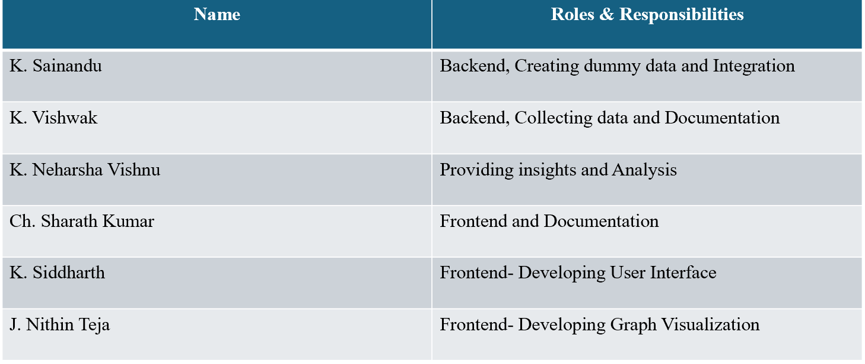

Work Breakdown and Task Allocation
Project Research and Initiation
click here to see spreadsheet

Slide 9
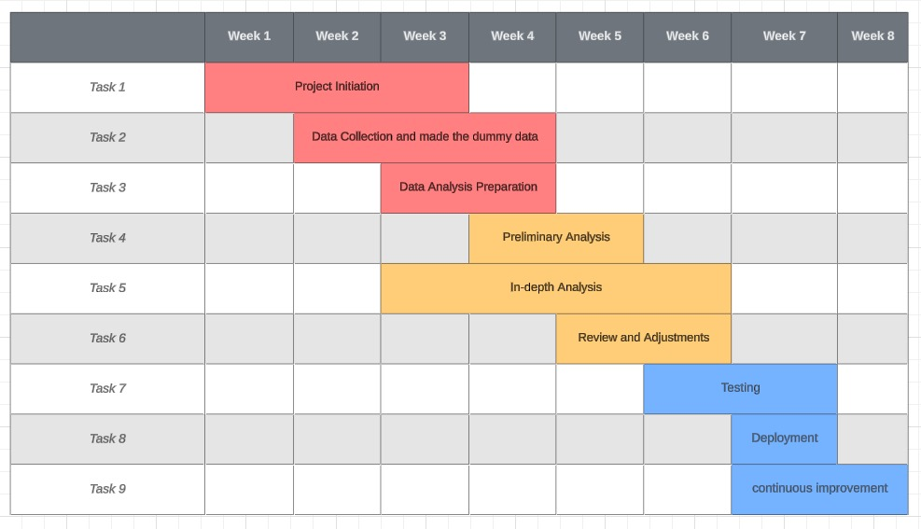
Gantt Chart
Project Research and Initiation
click here to see spreadsheet
Notes:
Notes:
Take each of the questions shown on the slide and answer them individually.
Discuss with your peers your thoughts. Are there consensus positions within the group?
If there are multiple viewpoints or different aspects of the work that are interesting, challenging, or “aha moments” for people please consider why the importance of these attributes may be different for different people

Slide 10
Milestones and Task Execution
Sl. No | Milestone | Details/Tasks related to milestone | Date of completion | People involved | Technologies or software used
1 | Project plan | Understanding the project, technologies , roles and responsibilities | 11/06/2024 | Entire Team | Jira
2 | Front-End | Developing user interface , Dashboard, profile | 01/07/2024 | Sharath Kumar, Siddharth, Nithin Teja | React
3 | Back-End | Generating graphs, Analyzing Data | 05/07/2024 | Sai Nandu, Vishnu, Vishwak | Python, Flask
4 | Developing API | Technology stack, Endpoints, Authentication | 16/07/2024 | Sai Nandu, Vishnu | REST Api
5 | Integrating Frontend and Backend | Defining endpoints, making http requests, Deployment | 19/07/2024 | Sai Nandu, Vishwak | React, Vue.js, Python, Flask, MySQL
6 | Testing & Debugging | Unit Testing, Integration Testing, Performance Testing | 22/07/2024 | Sharath, Sai nandu, Nithin Teja | Postman, pytest
7 | Deployment (optional) | Cloud platform | 25/07/2024 | Siddharth, Sai nandu | Any cloud platform
Project Research and Initiation

Slide 11
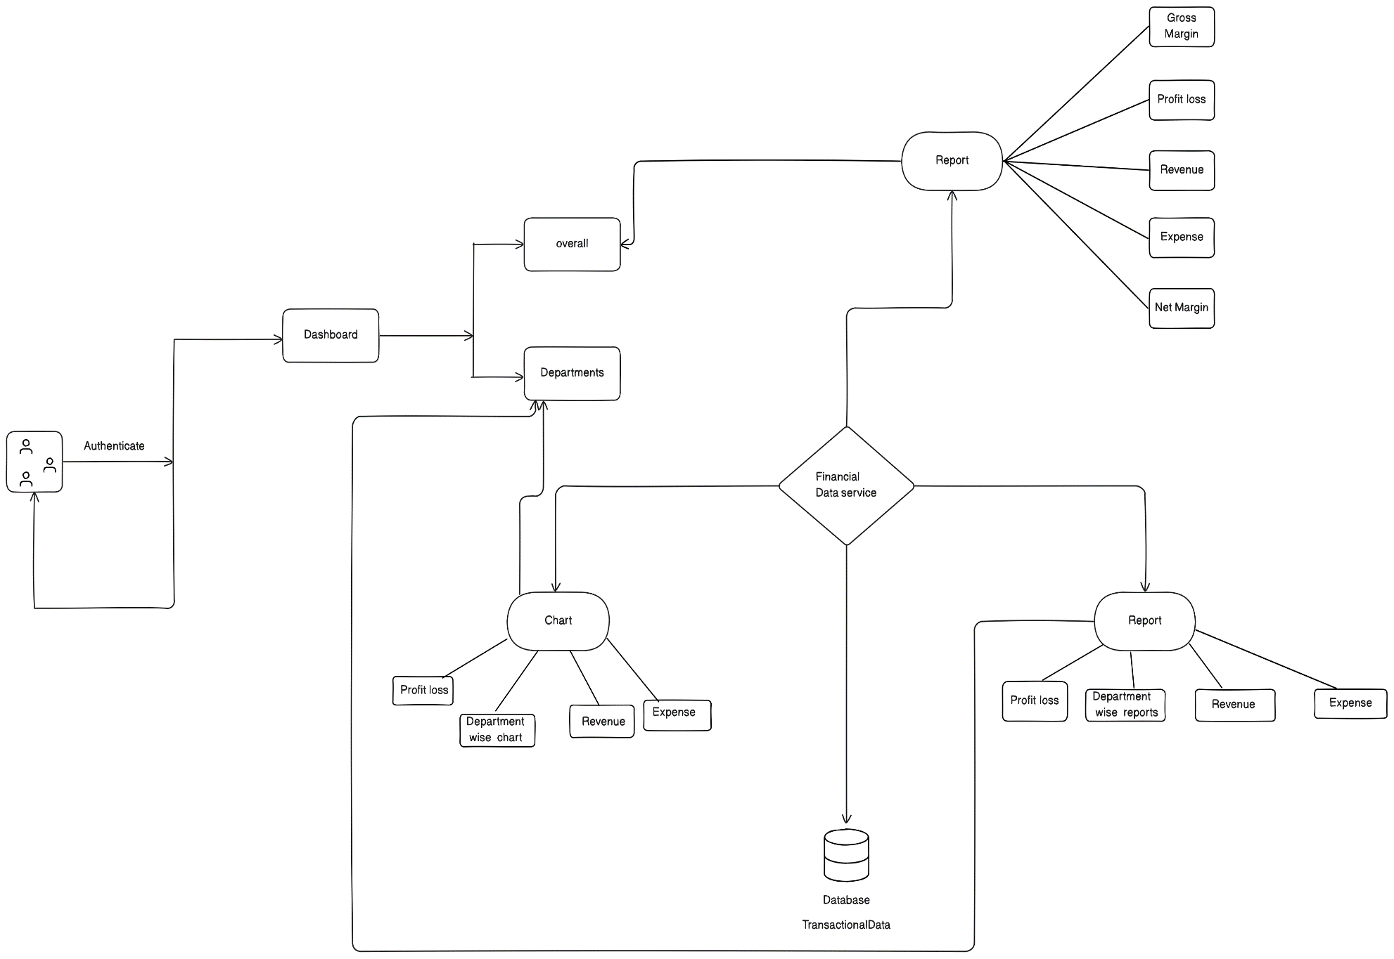
System Architecture
Project Development Cycle

Slide 12
Pros and Cons of Technologies used
Python with Flask (Backend):
Pros: Flask is lightweight and flexible, making it easy to set up and scale. It’s great for building RESTful APIs that your frontend can interact with
Cons: It may require more configuration compared to more heavyweight frameworks like Django, but it offers greater flexibility
React (Frontend):
Pros: React is excellent for building dynamic, responsive user interfaces. It’s also component-based, which helps in organizing frontend code effectively
Cons: There’s a learning curve if you’re new to React, and might need to integrate additional libraries for state management and routing
MySQL (Database):
Pros: MySQL is a well-established, reliable, and widely-used relational database. It’s good for handling structured data and supports complex queries
Cons: You’ll need to manage schema changes and ensure that our queries are optimized for performance
This stack worked well for visualizing and analyzing financial data. Flask will handle the backend logic and data processing, React will provide an interactive user interface for displaying the data, and MySQL will store and manage financial records.
Project Development Cycle

Slide 13
Project execution
Database (MySQL)
Setup: Started by designing the database schema to store financial data. tables for departments, transactions, revenue, expenditures, and profits. Defining the relationships between these tables
Implementation: Used MySQL Workbench to create and manage database, SQL scripts to create tables and insert initial data.
2. Backend (Python with Flask)
Setup: Installing Flask and setting up project environment. Flask will serve as the backend framework to handle requests and process data
API Development: Creating RESTful APIs using Flask to interact with the database
Data Processing: Implement business logic to calculate profits, losses, and other financial metrics
3. Frontend (React):
Setup: Created a React project using a tool like Create React App. This served as the client-side framework to build user interface
UI Design: Designed components to display financial data, such as charts and tables with the help of libraries like Chart.js,D3.js for visualizations
Project Development Cycle

Slide 14
4. Integration (RESTAPI):
Endpoints: Defining RESTful endpoints in Flask to handle different operations
Request Handling: Handling HTTP requests in Flask, processing the data, and sending JSON responses to the frontend
Frontend Requests: In React, making API calls to these endpoints to fetch data and update the UI accordingly. Ensuring to handle errors and loading states gracefully
Project Development Cycle
Execution Flow
Database Initialization: Creating MySQL database
Backend Development: Developing Flask APIs to interact with the database and process financial data
Frontend Development: Building the React application to display the data visually and interact with the API
Integration: Connecting the frontend to the backend via RESTful APIs, Testing end-to-end functionality to ensure data flows correctly between the database, backend, and frontend

Slide 15
Risks, challenges and mitigation
Integration Issues
Risk: Problems arised when integrating the frontend with the backend or connecting to the database
Mitigation Solutions:
1. API Documentation: Maintaining comprehensive API documentation to ensure clear communication between frontend and backend teams
2. Testing: Implementing unit tests and integration tests to catch issues early. Using tools like Postman for API testing.
3. Error Logging: Set up error logging and monitoring to track and resolve integration issues quickly.
Impact on Project:
1. Development Efficiency: Reduced integration time and delays caused by unknown issues
2. Reliability: Ensures that the application functions as intended with seamless data flow between components
Project Development Cycle

Slide 16
Change management
Added Upload Section to upload transaction data to minimize the work from user side
Added Download option to download the insights so that user can refer to them when offline.
Added Calendar to see analysis between the date
Project Development Cycle

Slide 17
Testing
Test Case 1: Valid CSV Upload
Description: Ensuring a valid CSV file is uploaded successfully
Steps:
Navigate to the upload page
Upload a valid CSV file
Expected Result: File is uploaded, processed, and data is stored in the database. A success message is displayed
Test Case 2: Invalid CSV Upload
Description: Ensuring that an invalid CSV file is rejected.
Steps:
Navigate to the upload page.
Upload an invalid CSV file (e.g., wrong format, missing columns).
Submit the file.
Expected Result: File is rejected, and an error message is displayed.
Project Development Cycle

Slide 18
Testing
3. Load Dashboard with Data
Description: Ensuring the dashboard loads correctly with data.
Steps:
Navigate to the dashboard page.
Expected Result: Dashboard displays all relevant data visualizations (transactions, profit, loss)
4. View Transactions
Description: Ensuring that the transactions page display all transactions correctly.
Steps:
Navigate to the transactions page.
Expected Result: All transactions are listed with correct details (date, amount, category).
5. Authentication and Authorization:
User Login
Description: Ensuring users can log in.
Steps:
Navigate to the login page.
Enter valid credentials.
Submit the form.
Expected Result: User is logged in and redirected to the dashboard.
Project Development Cycle

Slide 19
Testing Process
Unit Testing:
Testing individual components and functions
Testing individual components and functions
Tools: PyTest (for Python/Flask)
Integration Testing:
Testing interactions between different components
Ensuring data flows correctly through the system
Tools: Unittest (for Python)\
Performance Testing:
Testing the application's performance under load
Ensuring it can handle large volumes of data and concurrent users
Project Development Cycle

Slide 20
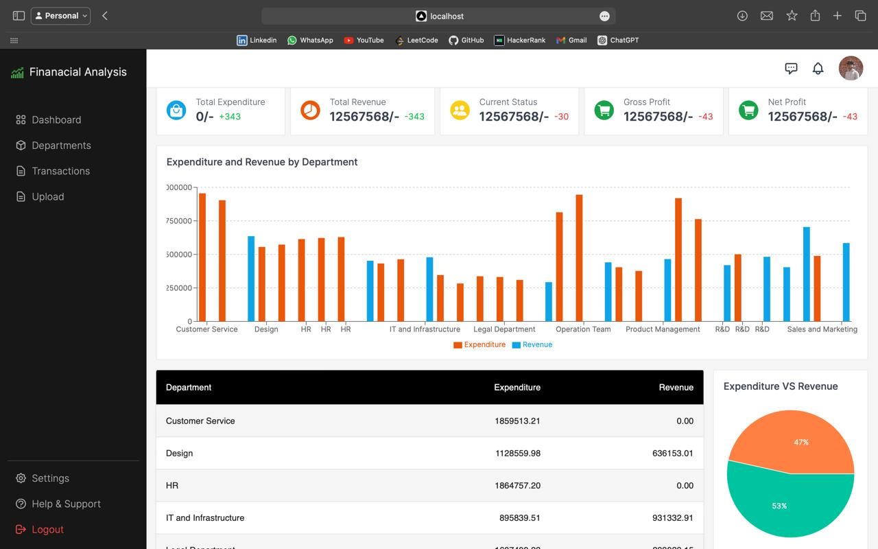
Screenshots of Project Execution
Dashboard
Project Development Cycle

Slide 21
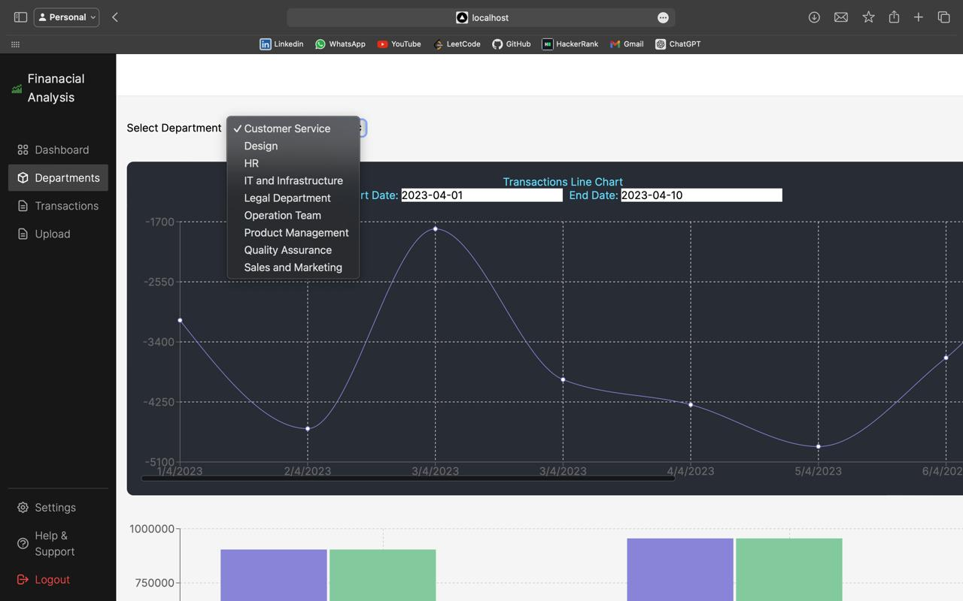
Department wise analysis
Project Development Cycle

Slide 22
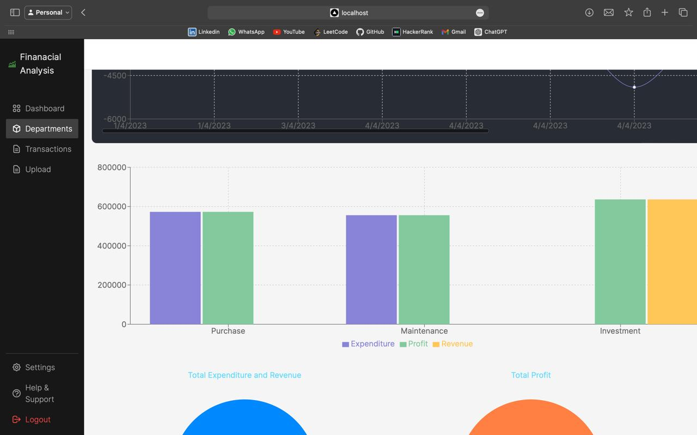
Graphs and Charts
Project Development Cycle

Slide 23
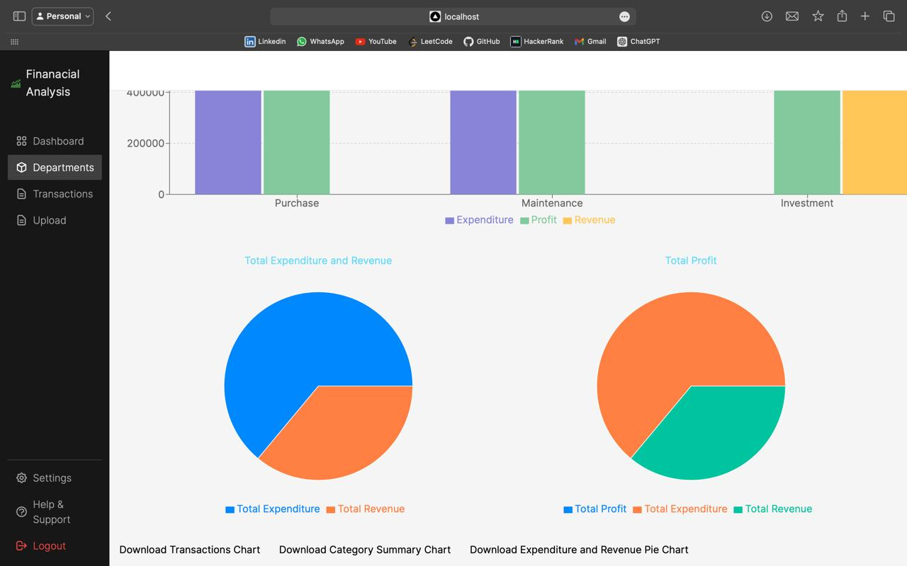
Graphs and Charts
Project Development Cycle

Slide 24
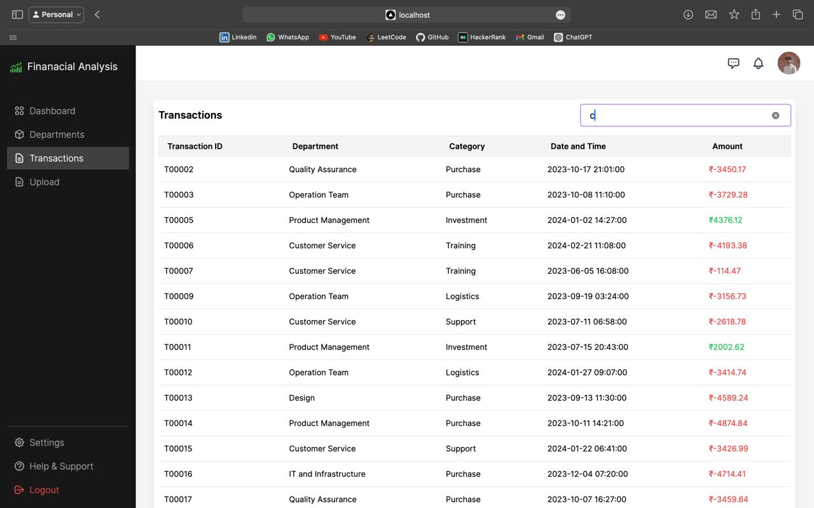
Transaction details
Project Development Cycle

Slide 25
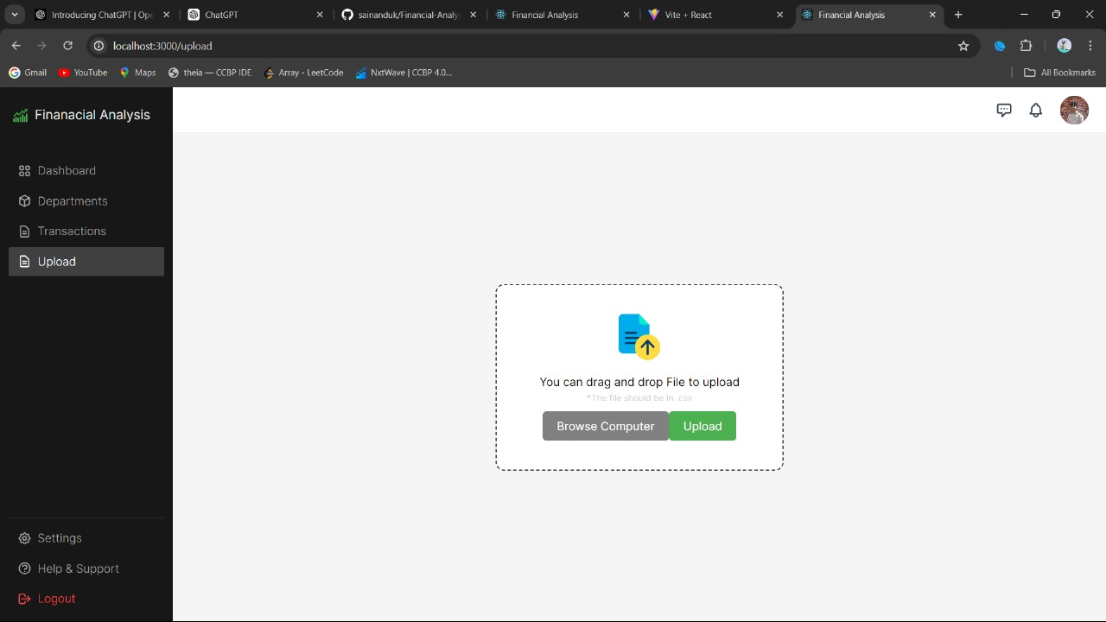
Upload
Project Development Cycle

Slide 26
Metrics for Success
User Satisfaction:
User Feedback: Collecting and analyzing user feedback through surveys, ratings, and reviews
Net Promoter Score : Measuring user willingness to recommend the tool to others
Financial Performance:
Cost Savings: Calculating any reduction in costs due to improved financial analysis and decision-making
Return on Investment (ROI): Measuring the financial return compared to the cost of developing and maintaining the tool
Performance:
Response Time: Measuring the average time, it takes for the application to respond to user requests.
Business Impact:
Decision-Making Quality: Evaluating improvements in the quality of business decisions made using insights from the tool
Operational Efficiency: Assessing the impact on operational efficiency, such as time saved in generating financial reports
Project Development Cycle

Slide 27
Recommendations for future work
Regular Updates and Maintenance:
Software Updates: Continuously update the application to fix bugs, improve performance, and add new features based on user feedback.
Security Patches: Regularly apply security patches to ensure the protection of sensitive financial data.
Database Maintenance: Periodically optimize and back up the database to maintain data integrity and performance.
Feedback and Improvement:
User Feedback: Implement mechanisms for users to provide feedback, such as surveys or feedback forms
Regular Reviews: Conduct regular reviews and assessments to identify areas for improvement and implement necessary changes
Project Development Cycle

Slide 28
Summary
The financial analysis project aims to provide a comprehensive platform for visualizing and analyzing an organization’s financial data, including profit, loss, expenditure, and revenue on a department-wise basis. The chosen tech stack Python with Flask for the backend, React for the frontend, and MySQL for the database provides a robust foundation for developing this application.
Components of the Project:
Database (MySQL):
Role: Stores structured financial data, including details about departments, transactions, and financial metrics
Features: Includes tables for storing data and relationships to ensure data integrity and consistency
2.Backend (Python with Flask):
Role: Handles server-side logic and processes requests from the frontend. Provides RESTful APIs for data retrieval and manipulation.
Features: Includes endpoints for accessing and updating financial data, using Flask-SQLAlchemy to interface with the MySQL database.
Project Development Cycle

Slide 29
3. Frontend (React):
Role: Provides an interactive and dynamic user interface for displaying financial data through charts and tables.
Features: Uses React components and libraries (e.g., Chart.js) to create visualizations and interact with backend APIs.
4. REST API Integration:
Role: Facilitates communication between the frontend and backend, allowing the frontend to fetch and display data.
Features: Implements standard HTTP methods (GET, POST, PUT, DELETE) to interact with Flask endpoints.
Project Development
Cycle

Slide 30

GitHub
Click Here for Git Repo
We have created separate branches i.e. Backend, Frontend and Documentation to organize the code effectively
Each member of the team made their contributions through pull request into the git hub repository and after having a word and confirming with the team lead
Code has been updated after completion of each task
Final commit will be updated after verification of mentor
Creation of Github Repository

Slide 31
Lessons learnt
Impact of project on society beyond science and technology
Financial Literacy: The project enhances financial literacy by providing clear visualizations of financial data. Users can better understand complex financial metrics and their implications.
Decision Making: By offering detailed insights into profit, loss, expenditure, and revenue, the project empowers business leaders and department heads to make informed decisions
Education: The project can be used as an educational tool in academic settings to teach students about financial analysis, data visualization, and the use of modern technologies in solving real-world problems
Interdisciplinary Work
Data Science: The project involves data analysis and visualization techniques, bridging the gap between software development and data science.
User Experience Design: Combines principles of design with software engineering to create an intuitive and user-friendly interface
Business and Finance: Integrates financial principles with technological solutions, providing practical tools for financial management and analysis
Project Reflection

Slide 32
Learning form project Developments
Technical Skills:
Backend Development: Gained proficiency in using Flask for developing RESTful APIs and connecting with MySQL databases
Frontend Development: Enhanced skills in building dynamic user interfaces with React and integrating data visualizations using libraries like Chart.js
Version Control: Improved collaboration and version control skills using Git and GitHub
Interdisciplinary skills
Understanding Financial Concepts: Gained a deeper understanding of financial concepts and their practical applications
User-Centric Design: Emphasized the importance of designing with the end-user in mind, creating a project that meets user needs and expectation
Soft Skills
Communication: Improved communication skills by documenting the project, writing clear API documentation, and presenting findings
Adaptability: Learned to adapt to new technologies and methodologies, staying updated with industry trends and best practices
Project
Reflection

Slide 33
References
Flask tutorials: https://youtu.be/oQWkuJhSMCQ?feature=shared
Flask Docs: https://flask.palletsprojects.com/en/3.0.x/
Python libraries for financial analysis: https://medium.com/@awaleedpk/top-python-libraries-for-financial-analysis-in-2024-b3b18c1e7efb
Importing and Visualizing financial data in Python: https://medium.com/@kt.26karanthakur/importing-and-visualising-financial-data-in-python-0bc560ea0259
React tutorials: https://youtu.be/1r79Eqw6tfg?feature=shared
Python for Financial Analysis: Advanced Techniques and Tools: https://medium.com/ai-in-plain-english/python-for-financial-analysis-advanced-techniques-and-tools-part-11-b687ece2b676
How to Make Your Data Visualizations Tell a Story: https://medium.com/@sdbutalla/how-to-make-your-data-visualizations-tell-a-story-58472d40fa2d
References

Slide 34
Acknowledgement
We extend our deepest gratitude to our project mentor Pravindra Kumar Gole, for his invaluable guidance and support throughout this project. His expertise and encouragement have been instrumental in shaping our work and ensuring its success. Our heartfelt thanks to Dr. Geetha Prakash and the ByteXL Team for providing us with this incredible opportunity to showcase our skills and knowledge. Their support and resources have been crucial to our project's development.
We would also like to acknowledge our team members for their dedication, hard work, and collaboration. Each member's contribution was vital to the project's success, and their teamwork and perseverance were exemplary.
Additionally, we appreciate the contributions of the open-source community. The tools and libraries they have developed and shared, including Flask, React, MySQL, and Chart.js, have significantly facilitated our development process. Their work has been indispensable to our project.
Acknowledgement

